Slide 1
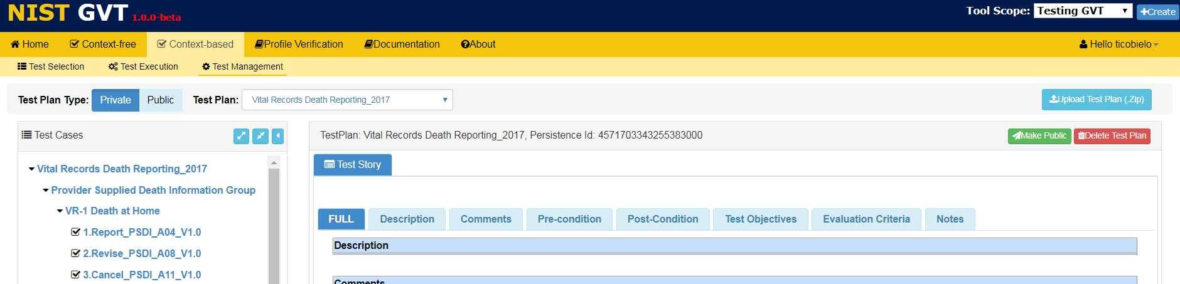
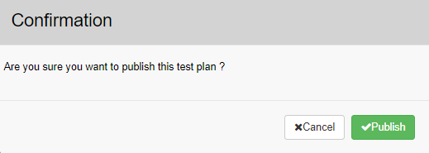
Context-based Test Management: Publishing a Test Plan
Click Make Public.
Using the Test Plan Type function in Context-based validation, click on Private and select a Private plan from the Test Plan dropdown menu.
Click on the root of the Test Plan in the Test Case tree to select the entire Test Plan.
3
2
1
A Public Test Plan is available to all GVT users if the Tool Scope is also Public. Any updates to a Public Test Plan will automatically be available to all GVT users if the Tool Scope is Public.
Click √Publish to change the Test Plan from Private to Public.
4

